Slide 1
Employees Are Learning New Skills on Their Own Time
Hypothetically, let's say there's a dynamic millennial on your company's marketing team. You've heard she's been doing amazing work, hitting all her goals and ultimately boosting your bottom line. What you may not know is that, at night and on weekends, she dives into online courses, learning new development skills, such as Java, web design or iOS.
At first, this scenario might lead you to premature conclusions: She's probably unhappy or disengaged in her current role. She's probably building a side gig that will distract her from her main job. She's probably looking to jump ship.
Your Top Employees Are Learning New Skills on Their Own Time. Here's What You Should Do. | Entrepreneur

Slide 2
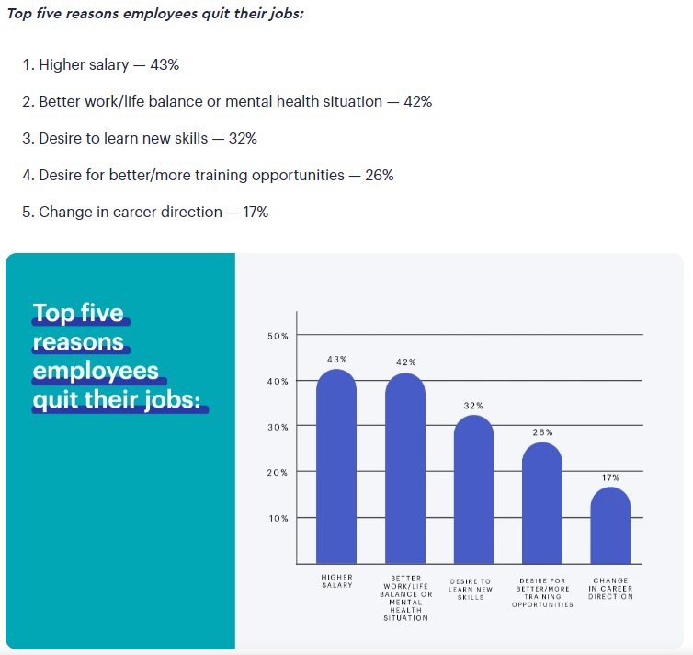
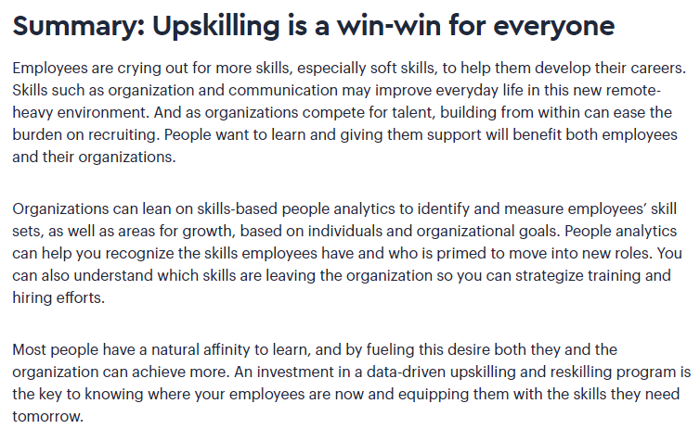
Why People Quit: The Surprising Reason No One Talks About | Visier | Visier

Slide 3
US EMPLOYEE TURNOVER STATISTICS [2023]
In 2022, the overall cost of voluntary employee turnover amounted to over $1 trillion.
33% of surveyed employees quit their job within the first 90 days that they’re employed.
As of 2021, 92% of Human Resources leaders state that their top priority is employee experience.
27 US Employee Turnover Statistics [2023]: Average Employee Turnover Rate, Industry Comparisons, And Trends - Zippia

